Slide 1
Brief review of my research programs for General Fusion
Xinhang Xu
10/7/2025

Slide 2
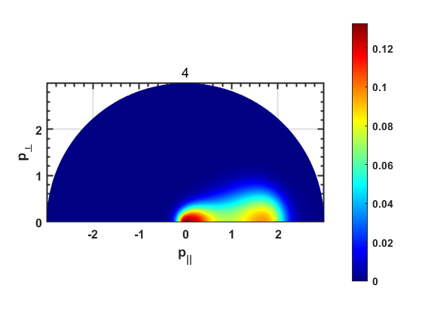
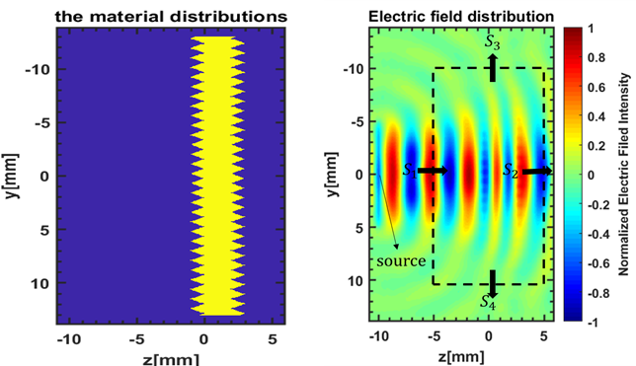
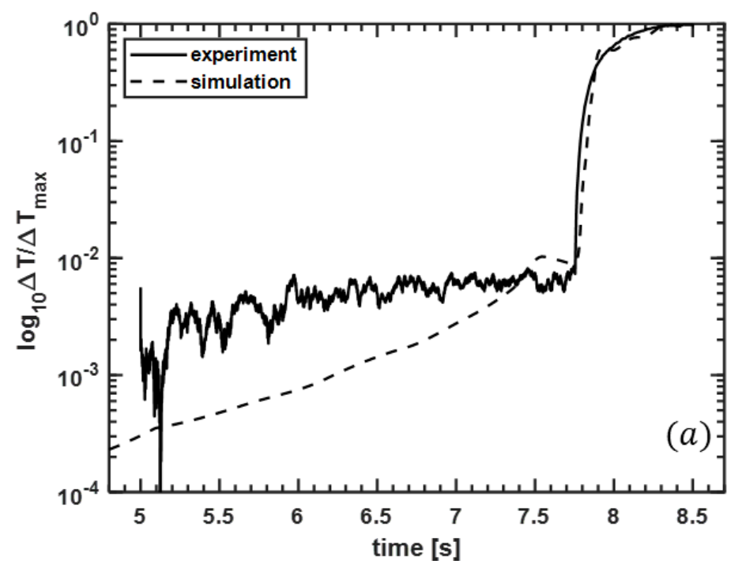
Works on simulations (During PHD at USTC)
From 2016-2023
Fork-plank Simulation
3D-ray tracing simulation
2D FDTD simulation
Synthetic Diagnostic
Mainly developed on MATLAB

Slide 3
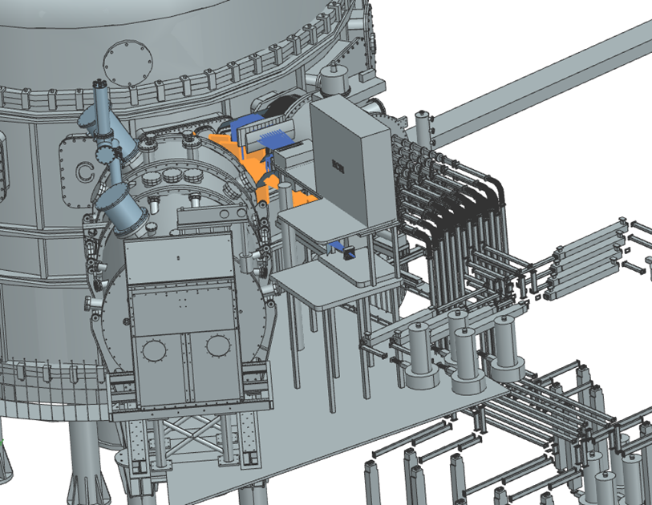
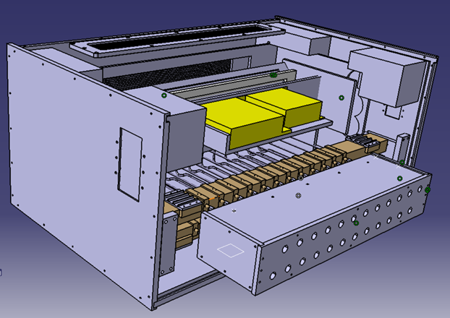
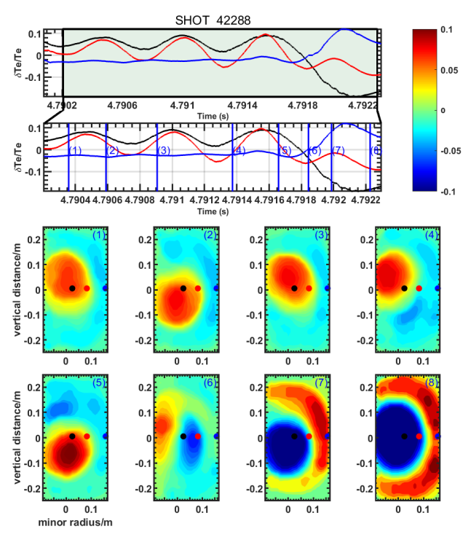
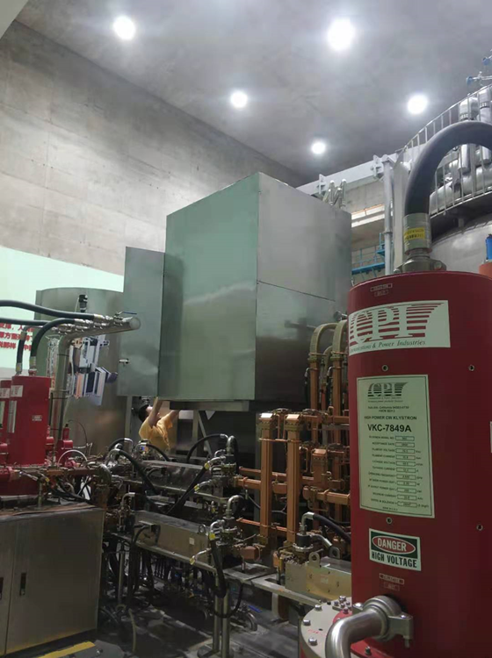
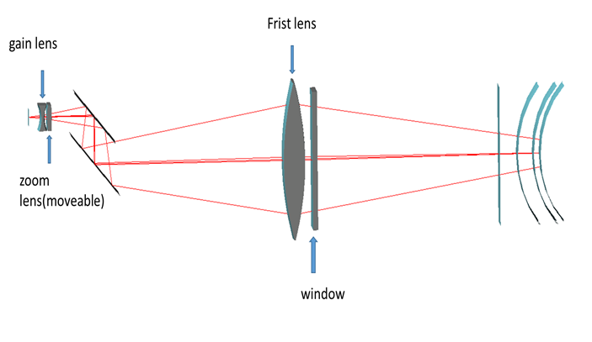
Works on Experiment (During PHD at USTC)
From 2016-2023
Design ECEI antenna Shielding
Design ECEI&MIR platform
Optical Design
Experiment data analysis
COMSOL Multiphysics, Catia, Code V

Slide 4
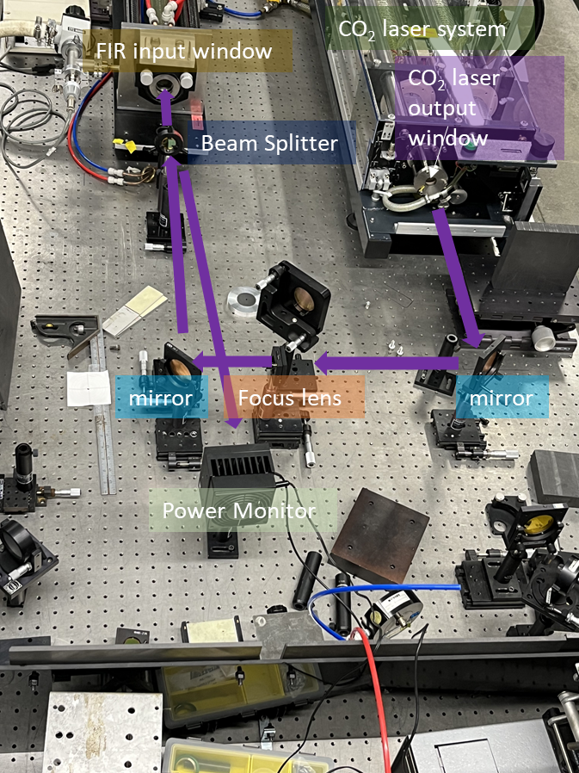
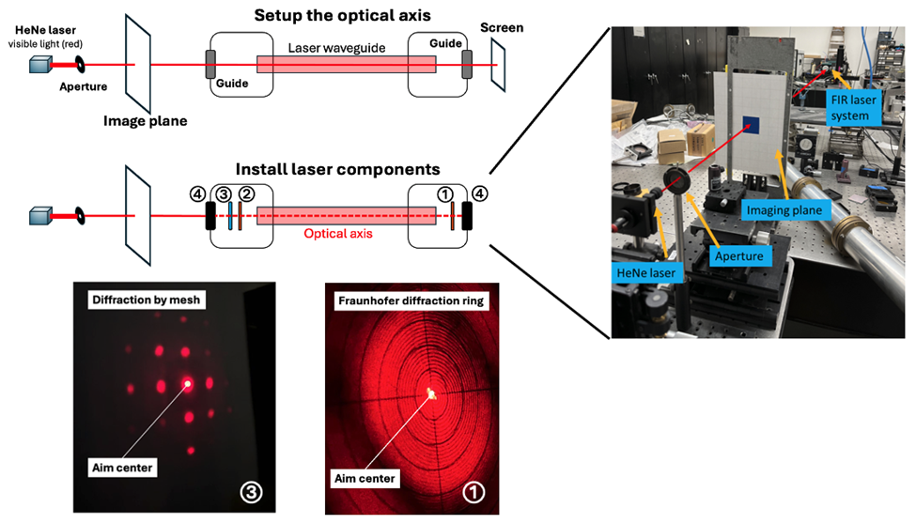
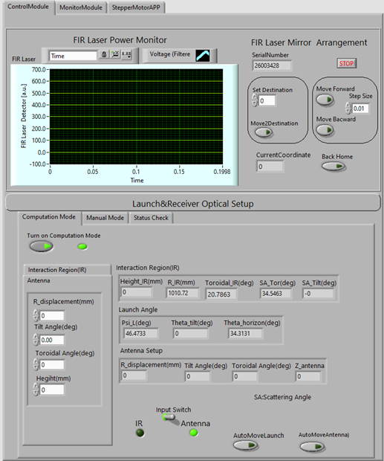
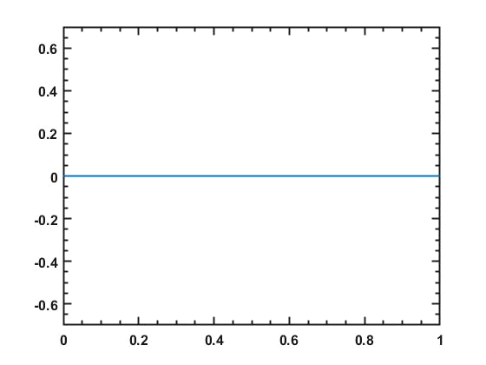
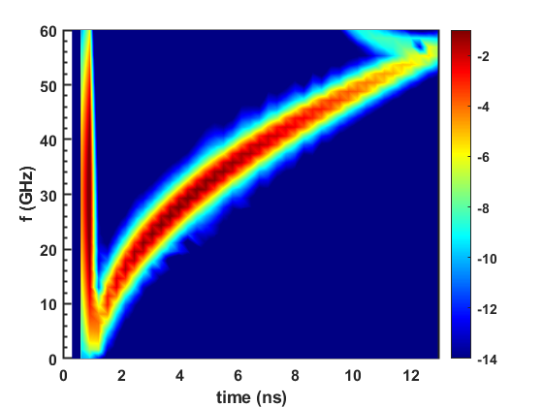
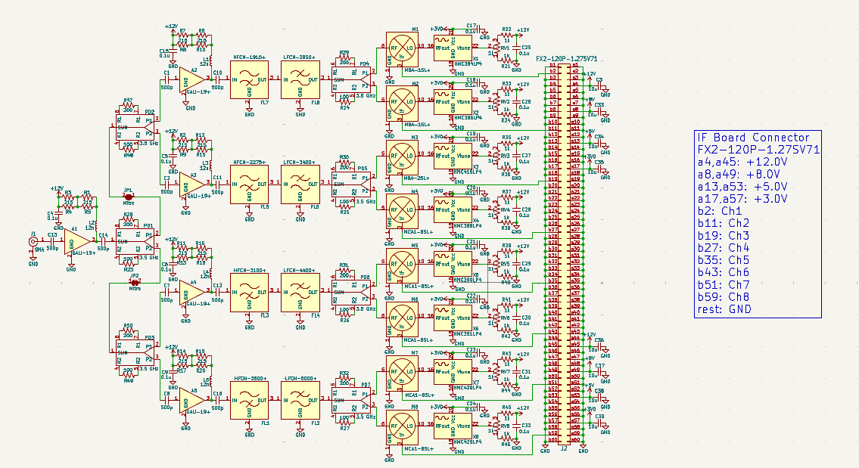
Works during Postdoc at UC Davis
From 2024-2025
High-k scattering laser design for NSTX-U
FIReTIP laser design for PPPL
1D FDTD simulation in plasma
RF board design for CTS on BEST
Ultra Short Plus Reflectometry simulation
E
z/m
Software: KiCAD, Python, LabVIEW

Slide 5
1.Collaborate with team, good at working with others or independently;
2.Strong motivation on plasma research;
3.Good at Self-learning;

